Slide 1
Lecture 146
Generalized Algorithm for Solving Space Partition Constraints

Slide 2
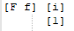
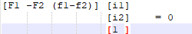
Algorithm for finding highest ranked synchronization-free affine partition.
INPUT : A program with affine array accesses.
OUTPUT : A partition.
Algorithm :
Find all pair of accesses which have data-dependency between them, F1 = <F1, f1, B1, b1> in statement s1 nested in d1 loops and F2 = <F2, f2, B2, b2> in statement s2 nested in d2 loops.
Let <C1, c1> and <C2, c2> represent the currently unknown partitions of statements s1 and s2.
The space partition constraints state that :
If : F1i1 + f1 = F2i2 + f2
then : C1i1 + c1 = C2i2 + c2.
For each pair of dependent accesses, we reduce the number of unknowns in the index vectors.
Fi + f is same vector as

Slide 3
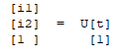
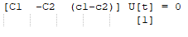

Algorithm (contd.)
We use Gaussian elimination to eliminate as many variables as possible until we are left with only variables that cannot be eliminated.
The resulting solution will have the form :
Where U is an upper-triangular matrix and t is a vector of free variables.
Substituting the vector (i1, i2, 1) in above, we can write the constraints on the partition as :
The above equations hold for all combinations of t if :
We can rewrite these equations in the form Ax = 0, where x is a vector of all the unknown coefficients of the affine partitions.

Slide 4
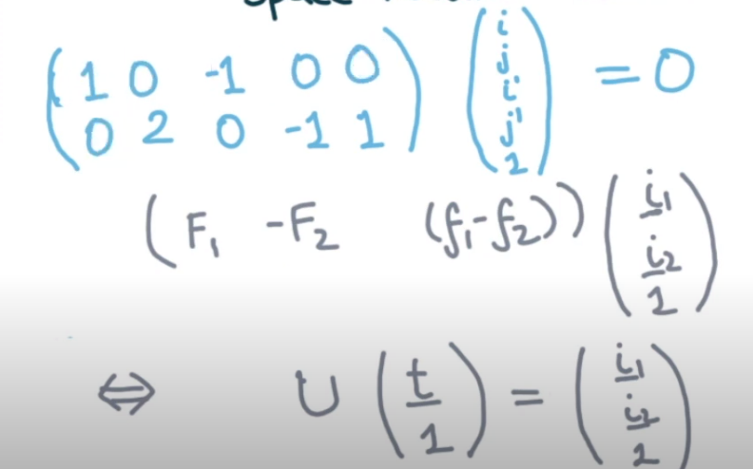
E.g to show sample U and t
Say F1 has axes [i, 2j], F2 has axes [i, j] and difference of the 2 additive constants evaluates to [0, 1].
4 unknowns i,j, i’,j’ and 2 linearly independent equations on those 4 unknowns.
Therefore degree of freedom remaining is 4-2 = 2.

Slide 5
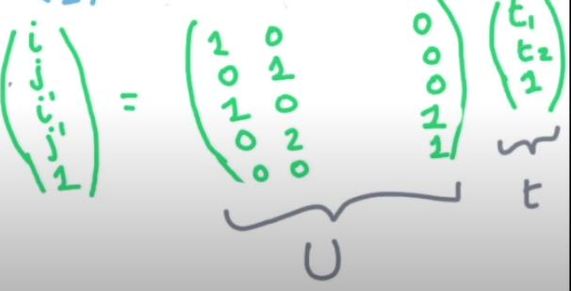
E.g continued
We want to write (i, j, i’, j’) in terms of U and t(t1, t2).
We are able to write the iteration indices in terms of only 2 free-variables.
It will help solving the space partition as it will be only 2-D.

Slide 6
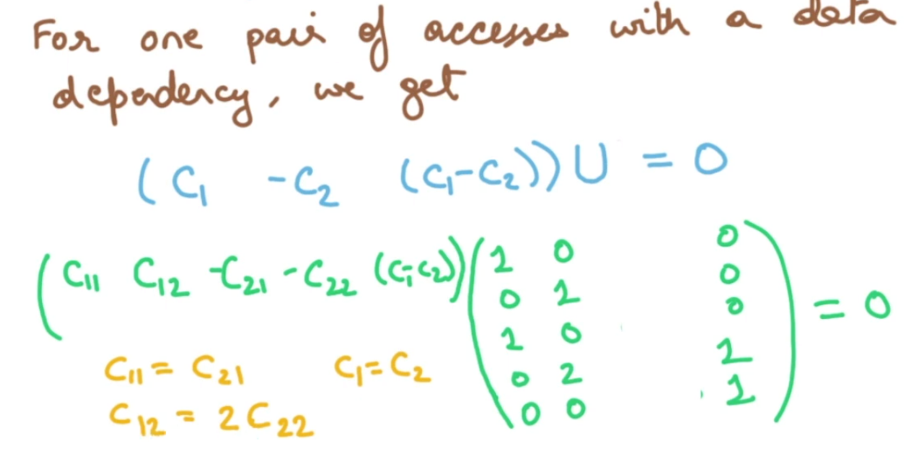
Algorithm continued
Since the rank of an affine partition is independent of the value of the constant terms in the partition, we eliminate all the unknowns that come from the constant vectors like c1 or c2, thus replacing Ax=0 by simplified constraints A’x’=0.
Find the solutions to A’x’ = 0, expressing them as B, a set of basis vectors spanning the null space of A’.
Find the constant terms. Derive one row of the desired affine partition from each basis vector in B, and derive the constant terms using Ax = 0.

Slide 7
Lecture 147
A simple code generation Algorithm.

Slide 8
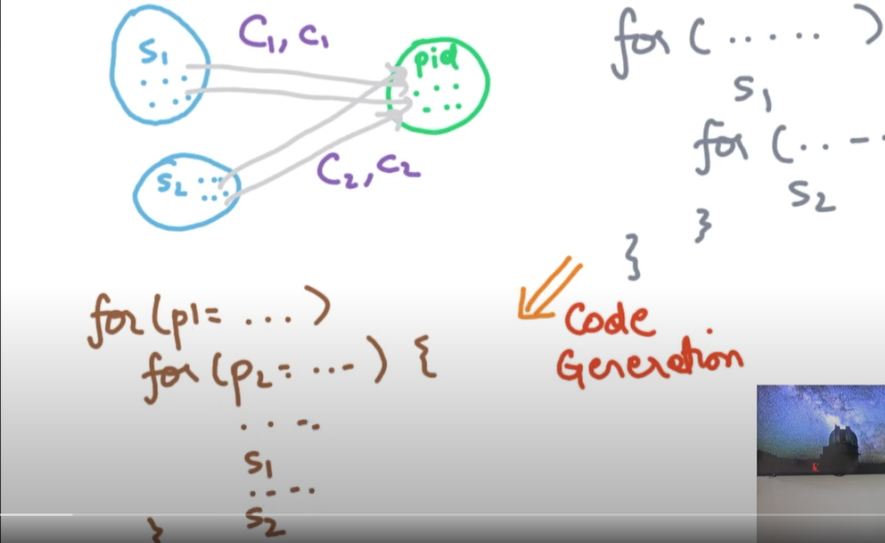
Code generation strategy
All iterations that are data-dependent are in inner loops and iterations not having any data dependence are in outer loops.
Meaningful from a locality perspective as reuse distance is less.
The generated code is amenable for parallelization across set of processors as well.

Slide 9
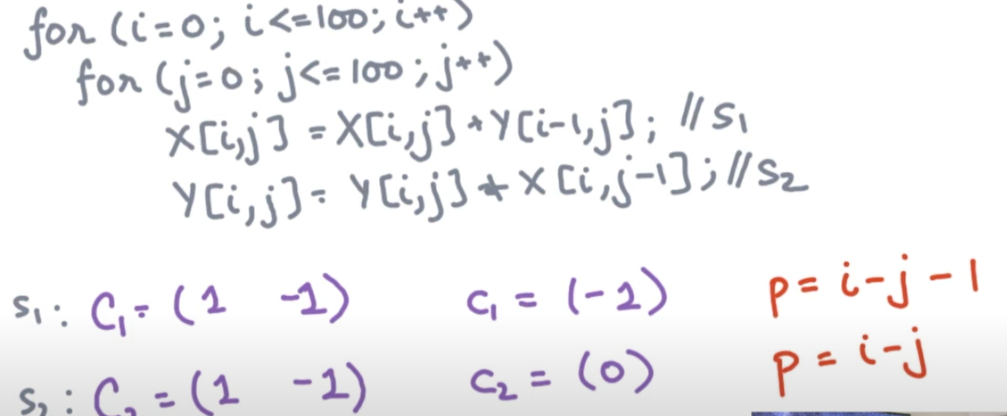
Code generation strategy
(i, j)th iteration of s1 is going to run on processor id evaluated from expression p = i-j-1
(i, j)th iteration of s2 is going to run on processor id evaluated from expression p = i-j

Slide 10
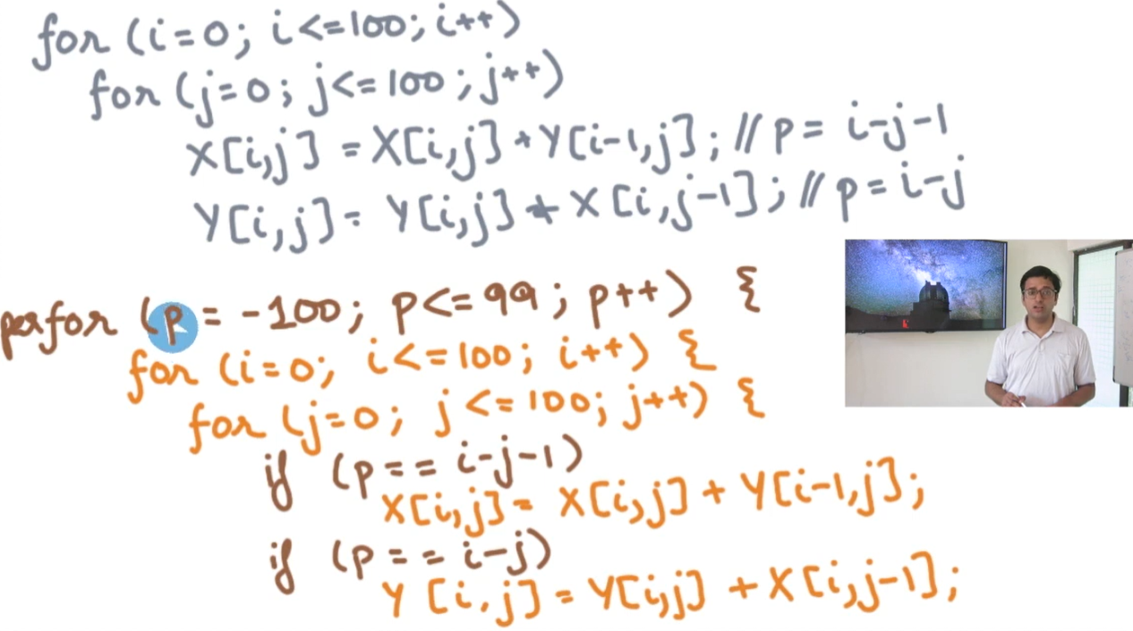
Code generation strategy
Execute the statement only if its the correct processor.
Check for p == i-j-1 and p == i-j.
How do we identify the UB and LB of p? Use Fourier Motzkin method.
Predicates are coming from the mapping function for the processor.

Slide 11
Space Partition Algo Code sketch
Generate outer loops for pid with depth equal to max rank of the coefficient matrix Ci across all statements si.
Identify lower and upper bound for each dimension of the pid.
Do this for each statement separately.
Take union of all convex ranges to get one convex range.
Paste the original program after predicating each statement, so that only the desired statement iteration indices are executed for the given processor.

Slide 12
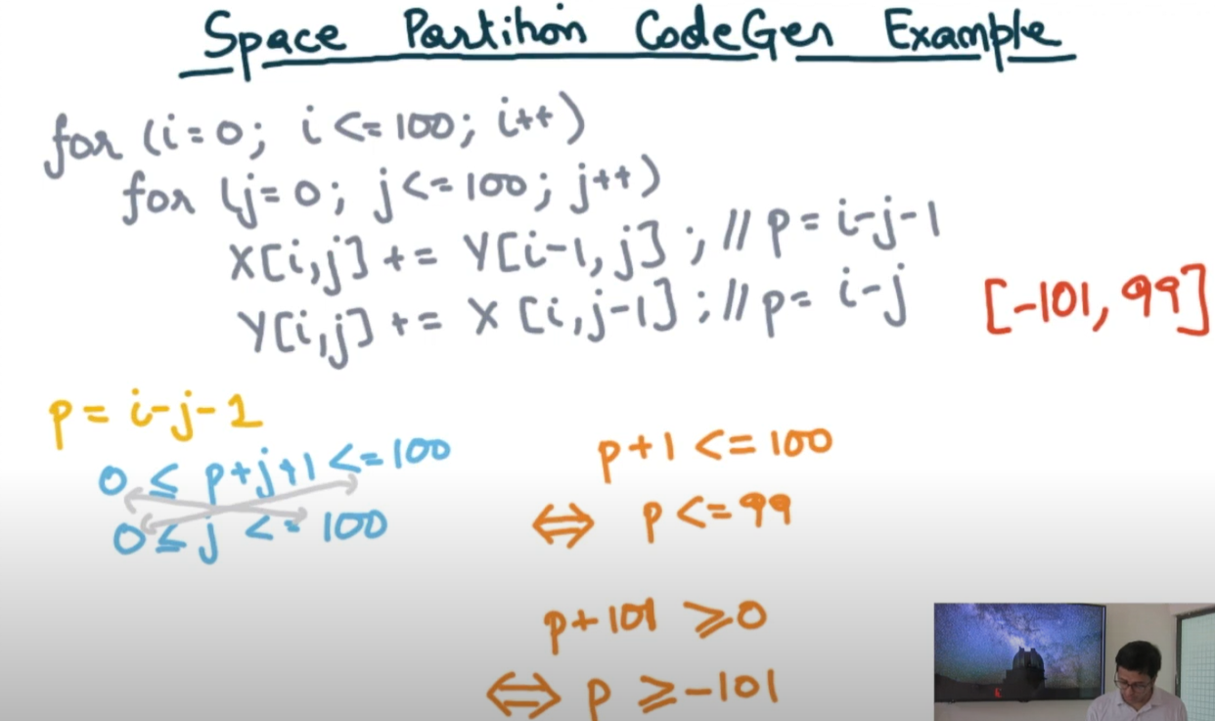
E.g
Inferring the range of process index.
We use Gaussian Elimination to remove i, and Fourier Motzkin for s1 to project 0 <= j <= 100 on 0 <= p+j+1 <=100.
We get p <=99 and p>=-101.
Similarly, if we do the same for s2, we would get p <= 100 and p>= -100.
We take the union of the above 2 derived inequalities, we get p>= -101 and p <= 100.

Slide 13
Lecture 148
Tightening the Loop Bounds for Synchronization Free Parallelism.

Slide 14
Tightening loop bounds
Our strategy to find the best possible reorganized loop :
Identify the space partitioning constraint.
Solve the space partitioning constraint to obtain max-rank affine function from iteration space to processor space.
Code-gen that makes the outer processor loops parallel, inner loops sequential and predicates the iteration/processor validity criteria.

Slide 15
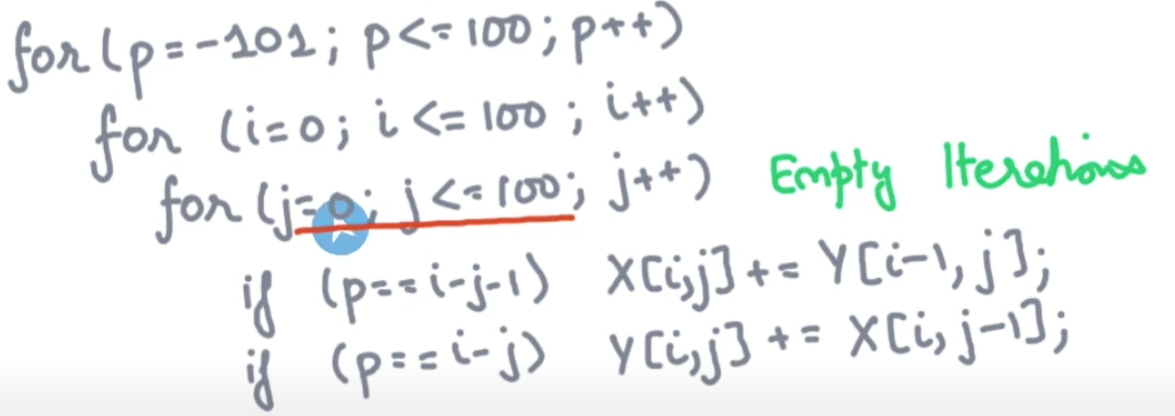
Motivation
Innermost loop will execute for 1 value of j, given a p, i.
Why do we need to iterate 100 times for j unnecessarily ?
Most of them are empty iterations.
We want to tighten the loops, i.e reduce the amount of work without changing the meaning of the program.

Slide 16
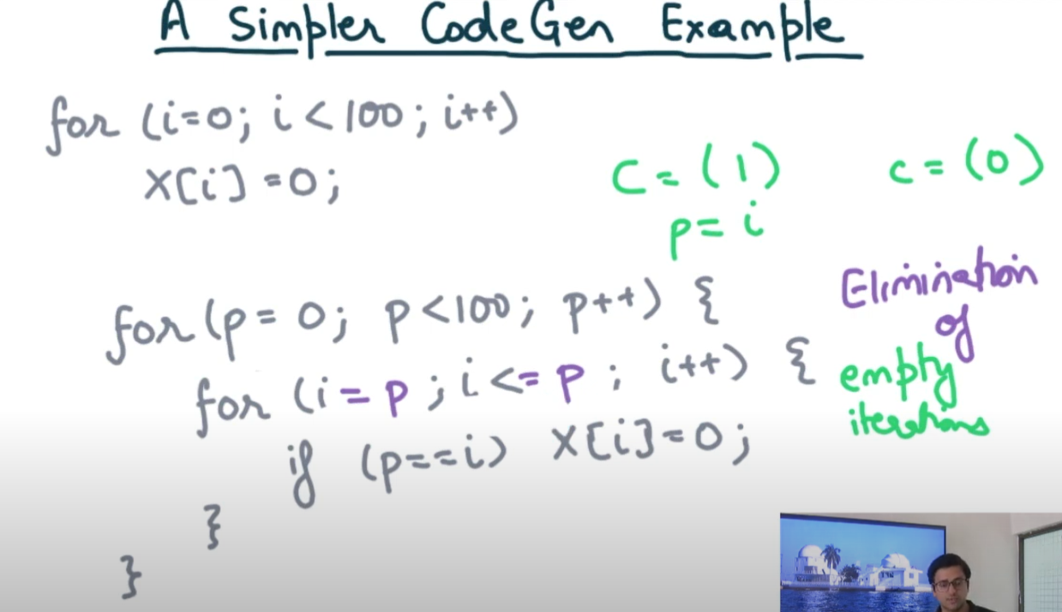
Simple Codegen example
98 iterations in the example shown are going to be empty.
Only 2 iteration have some effect.
We can tighten the loop bound as LB=p and UB=p. (we can still do better by eliminating the loop, to be covered later).
Use Fourier-Motzkin to find LB and UB doing appropriate projection of the polyhedron for each statement.

Slide 17
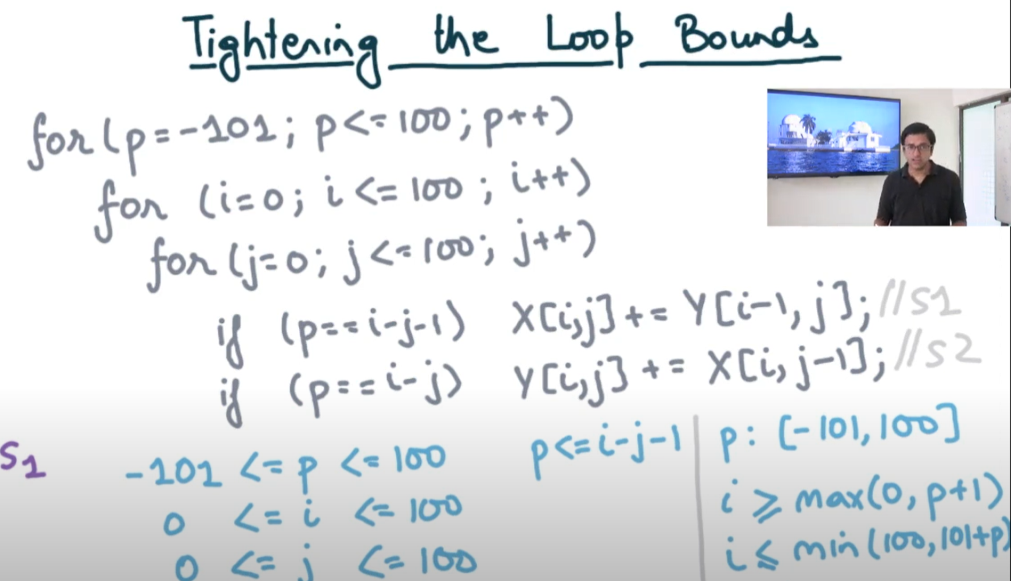
Tightening the loop bounds
Identify the constraints for s1, s2 and take a union.
Constraints are formed from the various loop bounds and predicate of the statement.
We represent the predicate constraint as a pair of 2 inequalities.
Use Fourier Motzkin to project on any dimension.
After fixing p, we can project remaining dimensions of the polyhedron i,j on i. From it we get the lower and upper bound of i.
Finally, after fixing p and i, we can project on j to find its upper and lower bound.

Slide 18
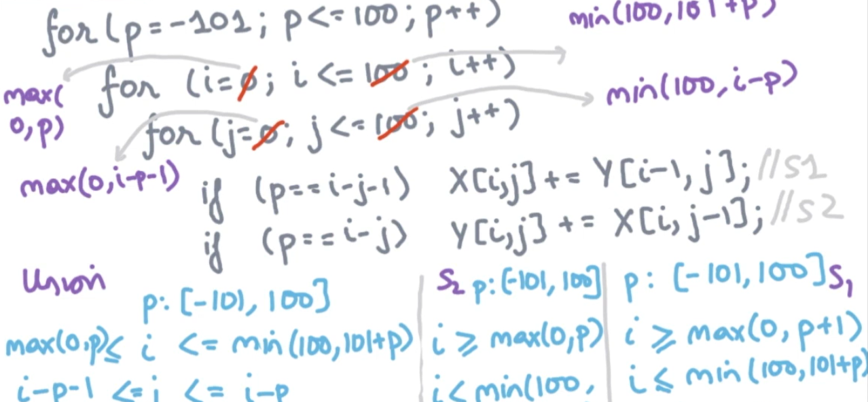
Tightening loop bounds contd.
We compute the bounds applicable for s2 similar to s1.
We take the union of these 2 polyhedron, result may not be a polyhedron.
We try to find the tightest polyhedron which encloses the 2 polyhedron.
Take the more liberal bound on each dimension.

